Slide 1

SEN111 CSE111 Intro to Information and Communication Technology
Computer in Daily Life
Lecture 2 (Week 1)
By Mr. Faheem Shaukat
faheem@iqraisb.edu.pk

Slide 2
How do computers solve problems?
Humans deconstruct problems into small operations that a computer can carry out
Writing an algorithm
Solve a problem by computer requires
State the problem clearly in a problem statement
Solve the problem with an algorithm that gives clear instructions
Use a computing agent to carry out the instructions

Slide 3
Stating the problem clearly
Describes what to do, not how to do it
How do I get from Iqra campus to the Centaurus?
Solve general classes of problems
How do I get from point A in Iqra campus to point B?
What is the square root of y?

Slide 4
Specifying a problem
Clear problem statement is called the specification
What information can we use as input
What the output, or solution, to our problem should look like
Specification for the square root problem
Input: A positive number y > 0
Output: A positive number x such that x² = y
Make sure specification is not ambiguous

Slide 5
Solving the problem using an Algorithm
Algorithm – a clear sequence of instructions for performing a task
a well-ordered sequence
of well-defined,
feasible operations
that takes finite time to carry out
Notes:
Well-ordered – the algorithm clearly indicates in what order to perform the operations
Well-defined distinguishes the one action to take out of the many possibilities
Feasible – the step can be carried out by a realistic computing agent in reasonable time and effort

Slide 6
Almost Algorithms
To shampoo your hair
Rinse
Lather
Repeat
To set the time on the
Camera
Open the menu panel
Push the button to find time setting option
Set the hours, then the minutes
To write up about something
Get paper and pencil
Sit down
Do the Brainstorming
Write words on paper
Arrange phrases to make paras
If it sounds great, quit. Otherwise, go back to step 3.

Slide 7
Using the computing agent
The square root algorithm is only an algorithm for an agent that understands English and can perform arithmetic
Requirements imposed by the computing agent
Algorithm is in a language the computing agent understands
Algorithm uses primitive operations that the agent can carry out

Slide 8
Necessity of artificial languages
Problems with natural languages (like English)
Flexible
Often ambiguous
Computers use artificial languages with precise meanings
programming languages
Programming languages define primitive operations computing agents understand
Notes:
List operations that may not be feasible
Ambiguous not well-defined “Police Help Dog Bite Victim”
Examples of artificial languages – mathematical equations, music notation, programming languages

Slide 9
What is computer science?
The study of computers
The study of algorithmic processes including their
Theory
Analysis
Design
Efficiency
Implementation
Application
Notes:
Study how to make computers more like us - to have flexibility in their instructions that allows them to decide which action is best under certain circumstances
Study which problems have solutions that can be solved in a reasonable amount of time
Study the most efficient ways to solve problems
Study how to make information more secure
Study how to improve communication between computers
Study how to improve the quality of computer programs
Study how to improve programming languages
Study how to improve the interaction between people and computers
Study how to improve people’s access to information
Study how to improve the ability of computers to graphically model the world

Slide 10
Computer Programming
Why study Programming?
A very interesting field
If mathematics is the mother of all sciences
then
Computer Science is the facilitator of all sciences
Google became the number one company in employees’ satisfaction and the number one resource of Google are Computer Scientists

Slide 11

Interesting Applications of Computer Programming
Google – Search Engine
Every one seems to be using Google
Market Value of Google is more than $ 50 Billions
Larry & Sergey were at the number 14 in the list of richest persons of the United States in 2006
Notes:
Highlight that software should be resuable and robust and safe

Slide 12
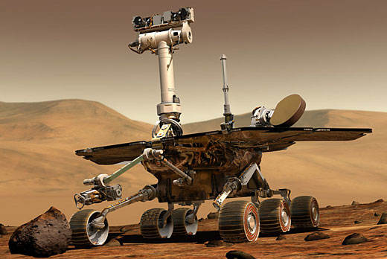
Interesting Applications of Computer Programming
Mars Path Finding mission
Mars Rover
Used in the
exploration of MARS
Uses software
Programs for
automatic
movement
Notes:
Software should be robust and reusable

Slide 13
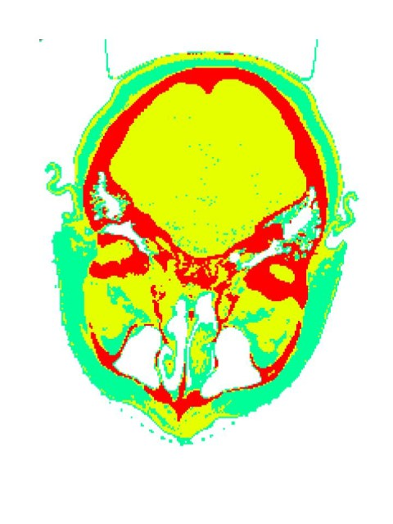
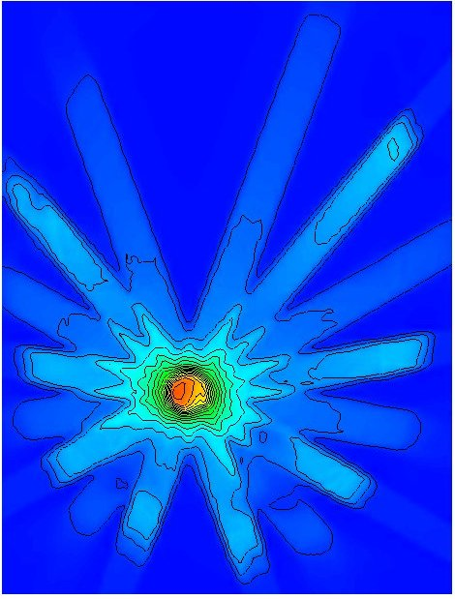
Interesting Applications of Computer Programming
Cancer Treatment
Acuros software developed in Los Alamos National Laboratory helps in
Precise modeling of patient’s anatomy
Precise focus and control of laser beams
Notes:
Softwares should be for good purpose ☺

Slide 14

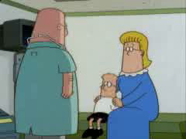
Interesting Applications of Computer Programming
Youtube – A Video Portal
Co-developed by Chad Hurley, Steve Chen and Jawed Karim
The most visited site in 2008
Acquired by Google in 2006 for USD 1.65 Billions
Notes:
Software should be Reusable, readable, scalable,

Slide 15

Interesting Applications of Computer Science
Facebook
Created by Mark Zuckerberg at the age of 19 when he was a student of Harvard University
In 2006, Microsoft purchased 1.6 % share of Facebook for $ 246 Million

